Slide 1

Machine Learning and Data Mining
Lecture 4.2: Hard-Margin Support Vector Machines

Slide 3
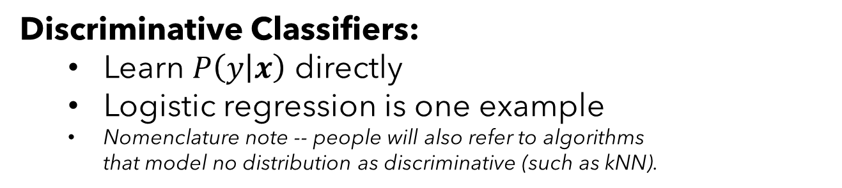
Generative vs. Discriminative Models
Discriminative Classifiers:
Learn $P\left(y | x\right)$ directly
Logistic regression is one example
Nomenclature note -- people will also refer to algorithms that model no distribution as discriminative (such as kNN).

Slide 4
Be able to answer:
What is the margin of a classifier?
What is a Support Vector Machine?
How is a hard-margin SVM formalized?
What is the dual formalization?
What is its decision boundary?
What is a support vector?
We’ll have to touch on a few math tools to do this:
Constrained Optimization with Lagrange Multipliers
Quadratic Programming Solvers
You do not need to have an operational understanding of these two techniques at all for this course.

Slide 5
A Motivating Discussion

Slide 6
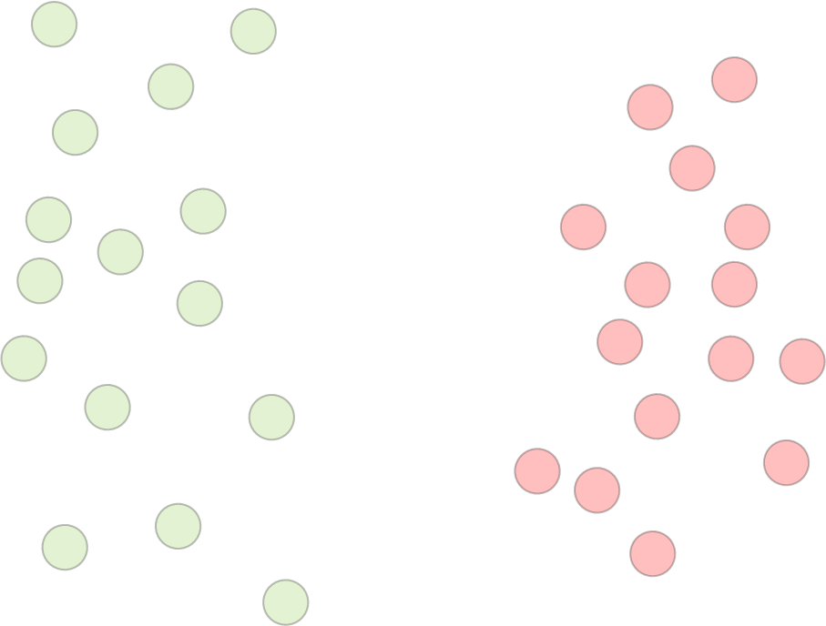
B
D
A
C
I prefer A
I prefer B
I prefer C
I prefer D

Slide 7

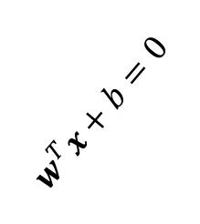
A Motivating Discussion
$$w^{T}x+b=0$$
$$w$$

Slide 8

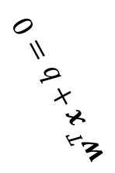
A Motivating Discussion
$$w^{T}x+b=0$$
$$w$$

Slide 9

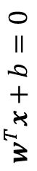
A Motivating Discussion
$$w^{T}x+b=0$$
$$w$$

Slide 10
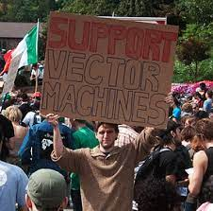
New Topic: Support Vector Machines
Algorithm Name: Support Vector Machines (SVM)
Type: Supervised Linear Classifier
Key Idea: Find the linear decision boundary that maximizes the margin between positive and negative examples.
What is a support vector? We’ll need to run through a lot of somewhat unintuitive math to really understand the structure of this problem. But the result will give us tremendous insight into this problem … and it’ll build character.

Slide 11
Web Demo
https://jgreitemann.github.io/svm-demo

Slide 12

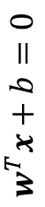
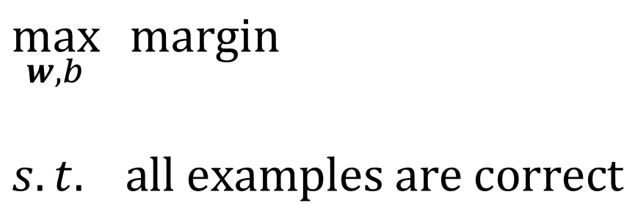
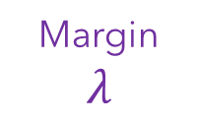
Max-Margin Classifiers
Our goal for today:
We want to find a classifier that separates the classes while maximizing the margin between positive and negative examples. For now, we’ll assume linear separability and fix that later.
$$w^{T}x+b=0$$
$$w$$
$$\max_{w,b}{ margin}$$
$$s.t. all examples are correct$$
Margin
$$λ$$

Slide 13
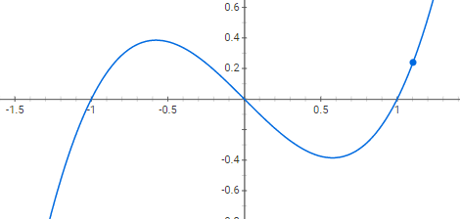
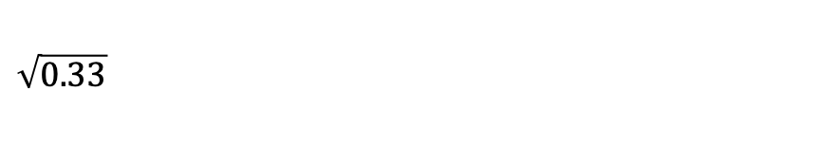
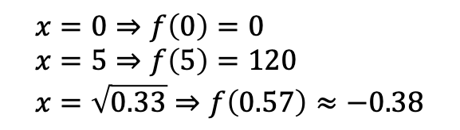
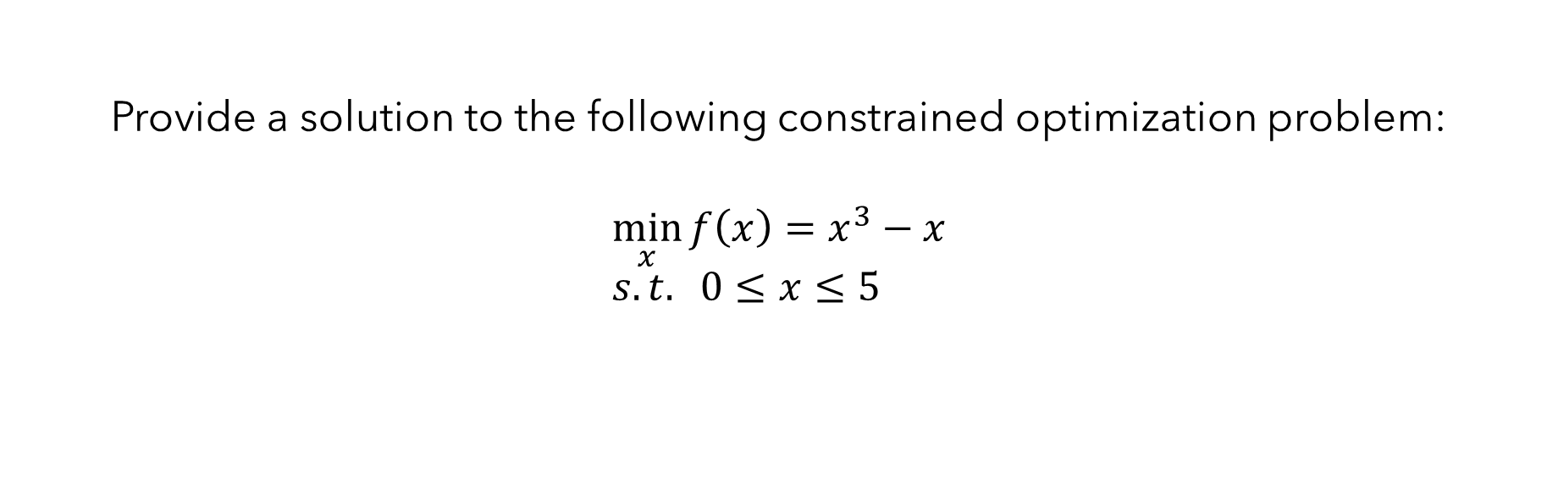
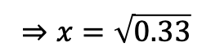
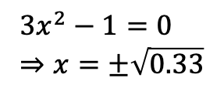
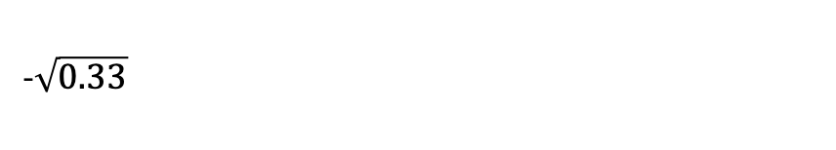
Provide a solution to the following constrained optimization problem:
$$\min_{x}{f\left(x\right)=x^{3}}−x \\ s.t. 0≤x≤5$$
$$3x^{2}−1=0 \\ ⇒x=±\sqrt{0.33}$$
$$⇒x=\sqrt{0.33}$$
$$x=0⇒f\left(0\right)=0 \\ x=5⇒f\left(5\right)=120 \\ x=\sqrt{0.33}⇒f\left(0.57\right)≈−0.38$$
0
5
$$\sqrt{0.33}$$
-$\sqrt{0.33}$

Slide 14

Max-Margin Classifiers
Our goal for today:
We want to find a classifier that separates the classes while maximizing the margin between positive and negative examples. For now, we’ll assume linear separability and fix that later.
$$w^{T}x+b=0$$
$$w$$
Our plan of attack:
Set up some convenient notation
Derive an expression for our intuition
Set up a constrained optimization problem
Solve it to arrive at a Support Vector Machine
(some new math tools to analyze this– Lagrange multipliers)
Margin
$$λ$$

Slide 15
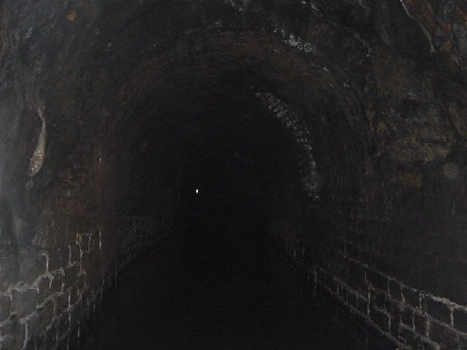

Slide 16
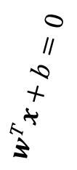
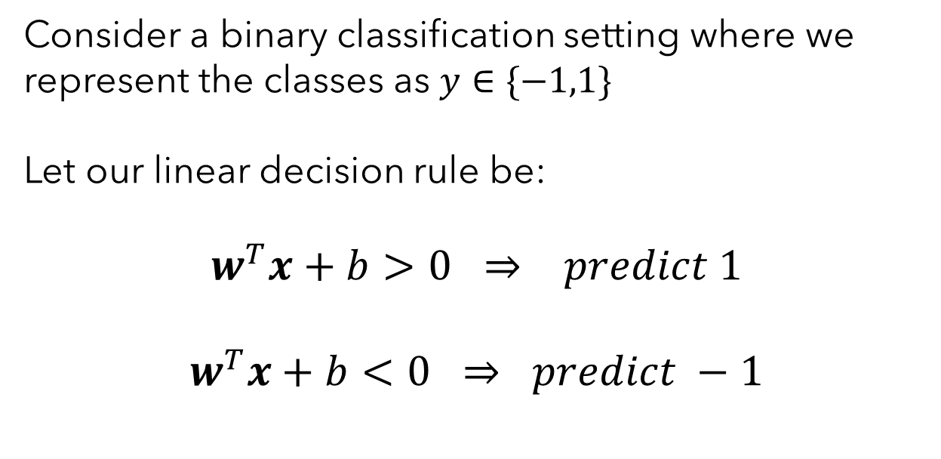

Step 1) Establish Some Convenient Notation
Problem Setup and Decision Rule
Consider a binary classification setting where we represent the classes as $y∈\{−1,1\}$
Let our linear decision rule be:
$$w^{T}x+b>0 ⇒ predict 1$$
$$w^{T}x+b<0 ⇒ predict −1$$
$$w^{T}x+b=0$$
$$w$$

Slide 17
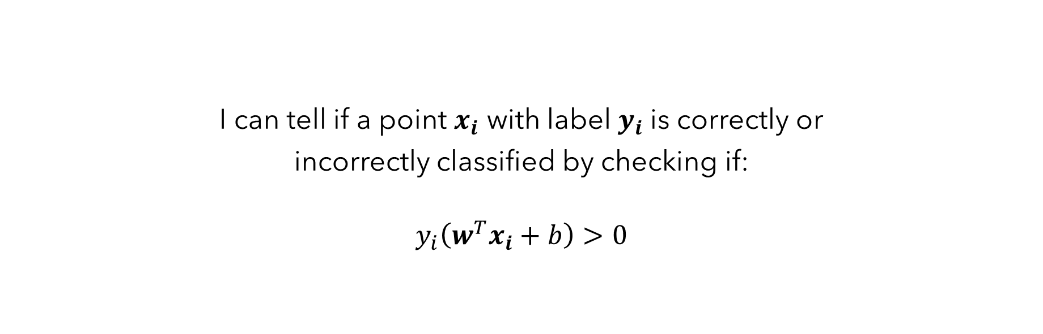
I can tell if a point $x_{i}$ with label $y_{i}$is correctly or
incorrectly classified by checking if:
$$y_{i}\left(w^{T}x_{i}+b\right)>0$$
True
False
I don’t know

Slide 18
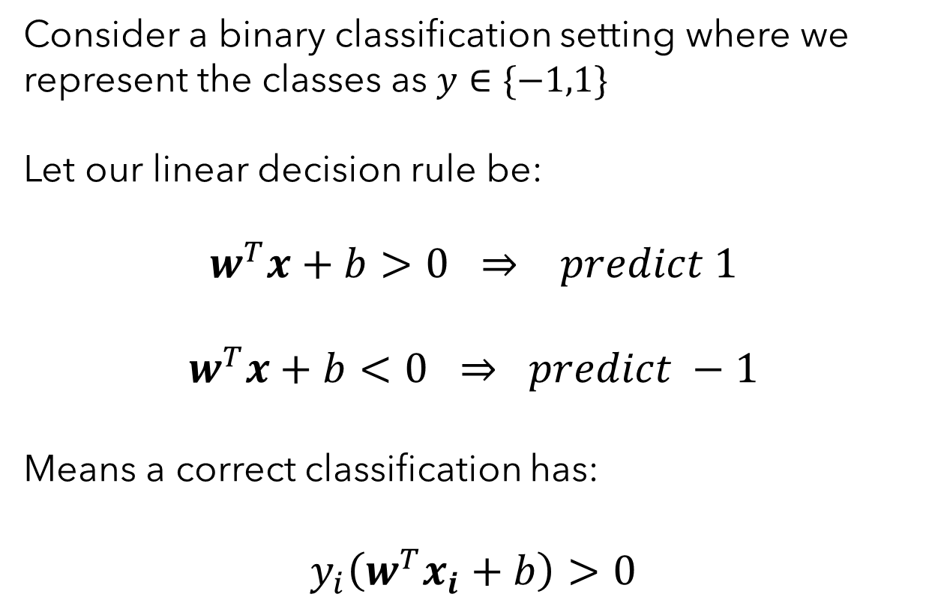
Step 1) Establish Some Convenient Notation
Problem Setup and Decision Rule
Consider a binary classification setting where we represent the classes as $y∈\{−1,1\}$
Let our linear decision rule be:
$$w^{T}x+b>0 ⇒ predict 1$$
$$w^{T}x+b<0 ⇒ predict −1$$
Means a correct classification has:
$$y_{i}\left(w^{T}x_{i}+b\right)>0$$
$$w^{T}x+b=0$$
$$w$$

Slide 19
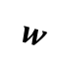

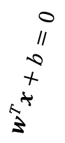
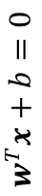
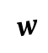
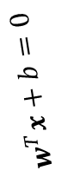
Step 2) Derive an Expression for the Margin
Intuition: One way to talk about the margin of our classifier would be to measure how close the nearest point is to the boundary.
$$w^{T}x+b=0$$
$$w^{T}x+b=0$$
$$w^{T}x+b=0$$
$$w$$
$$w$$
$$w$$

Slide 20
The shortest path from a point to a line is perpendicular to the original line and parallel to the vector of weights defining it.
True
False
I don’t know
I don’t understand the question.

Slide 21
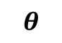
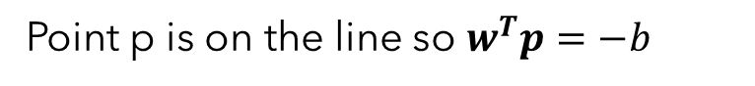



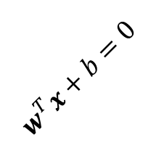




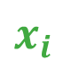


Step 2) Derive an Expression for the Margin
Goal: Find distance d.
$$x_{i}$$
Cos → adjacent over hypotenuse:
$$\cos\left(θ\right)=\frac{d}{|\left|x_{i}−p\right||}$$
$$d$$
Definition of dot product:
$$w^{T}x+b=0$$
$$\frac{w^{T}(x_{i}−p)}{\left\|w\right\|\left\|x_{i}−p\right\|}=\frac{d}{|\left|x_{i}−p\right||}$$
$$x_{i}−p$$
$$d$$
Point p is on the line so $w^{T}p=−b$
$$θ$$
$$d=\frac{w^{T}(x_{i}−p)}{\left\|w\right\|}=\frac{w^{T}x_{i}+b}{\left\|w\right\|}$$
$$w$$
$$p$$
Absolute value to remove sign:
$$d=\frac{\left|w^{T}x_{i}+b\right|}{\left\|w\right\|}$$

Slide 22

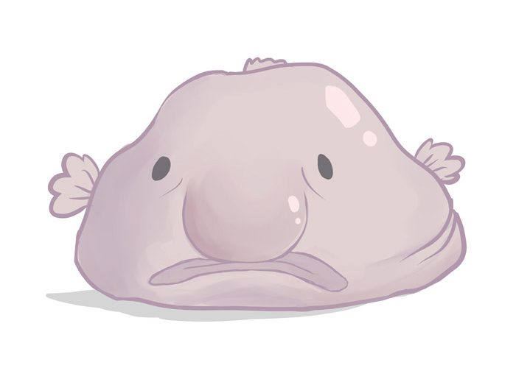
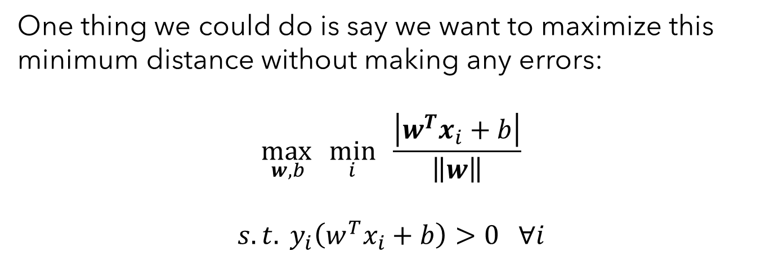

Step 3) Set Up A Constrained Optimization Problem
We can then write the distance to the decision boundary from the nearest point as:
$$w^{T}x+b=0$$
$$d_{min}=\min_{i}{\frac{\left|w^{T}x_{i}+b\right|}{\left\|w\right\|}}$$
One thing we could do is say we want to maximize this minimum distance without making any errors:
$$\max_{w, b }\min_{i}{\frac{\left|w^{T}x_{i}+b\right|}{\left\|w\right\|}}$$
$$s.t. y_{i}\left(w^{T}x_{i}+b\right)>0 ∀i$$
$$w$$
Maximize distance to nearest point
While not making any errors
This is an ugly problem! Max of min? $w$’s everywhere?

Slide 23

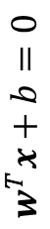
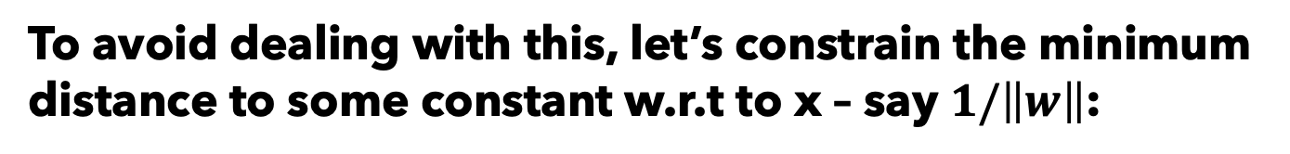
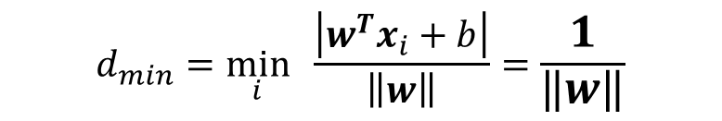
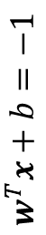
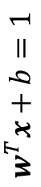
Step 3) Set Up A Constrained Optimization Problem
To avoid dealing with this, let’s constrain the minimum distance to some constant w.r.t to x – say $1/\left\|w\right\|$:
$$w^{T}x+b=1$$
$$w^{T}x+b=0$$
$$w^{T}x+b=−1$$
$$d_{min}=\min_{i}{\frac{\left|w^{T}x_{i}+b\right|}{\left\|w\right\|}}=\frac{1}{\left\|w\right\|}$$
$$|w^{T}x_{i}+b|≥1 ∀i$$
Can combine with “correctness” constraint $y_{i}\left(w^{T}x_{i}+b\right)>0$:
$$w$$
$$y_{i}\left(w^{T}x_{i}+b\right)≥1 ∀i$$
What does this do?
Makes a space around the classifier where points aren’t allowed to be – between the green and red lines.
w can be rescaled arbitrarily to make this true without changing the classifier’s expressiveness.

Slide 24
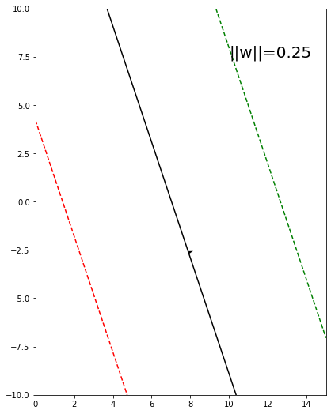
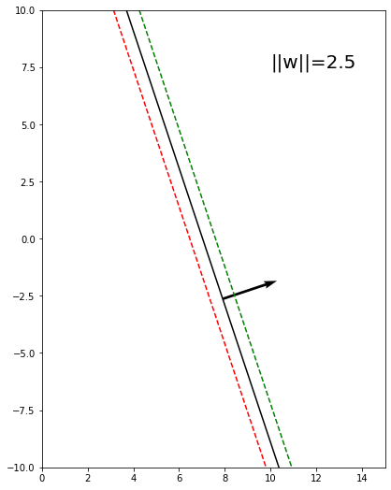
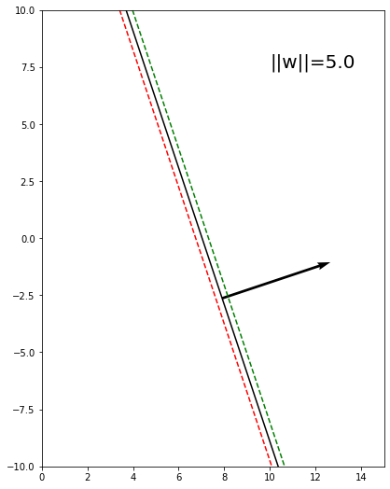
Step 3) Set Up A Constrained Optimization Problem
w can be rescaled to make this true without changing the classifier’s expressiveness.

Slide 25

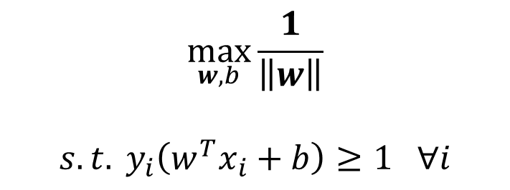
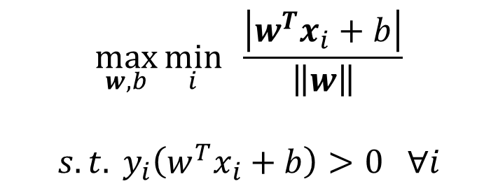
Step 3) Set Up A Constrained Optimization Problem
How does this change our “ugly” objective to something nicer?
$$\max_{w, b}\min_{i}{\frac{\left|w^{T}x_{i}+b\right|}{\left\|w\right\|}}$$
$$s.t. y_{i}\left(w^{T}x_{i}+b\right)>0 ∀i$$
$$\max_{w, b}\frac{1}{\left\|w\right\|}$$
$$s.t. y_{i}\left(w^{T}x_{i}+b\right)≥1 ∀i$$
You: Neat math. Cute fish. How does this relate to the margin?

Slide 26
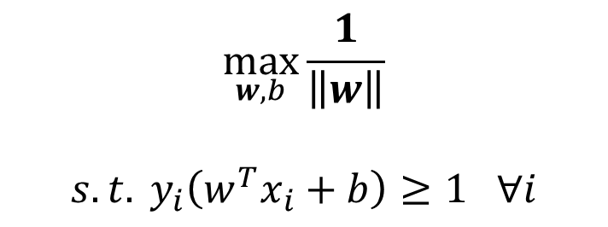
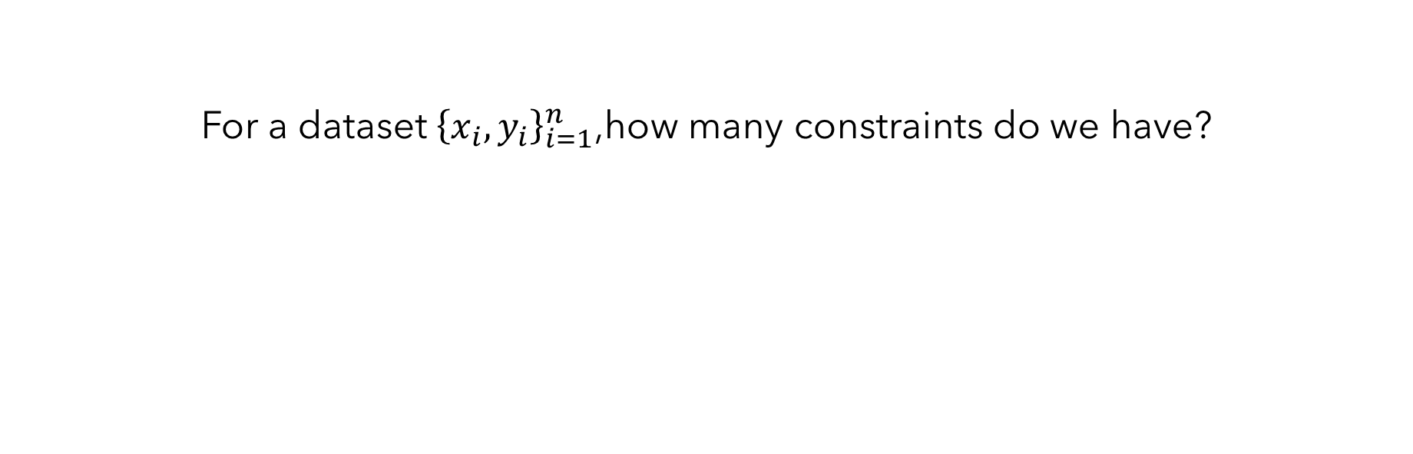
For a dataset ${\left\{x_{i}, y_{i}\right\}}_{i=1}^{n}$,how many constraints do we have?
$$\max_{w, b}\frac{1}{\left\|w\right\|}$$
$$s.t. y_{i}\left(w^{T}x_{i}+b\right)≥1 ∀i$$
1
d
n
2

Slide 27
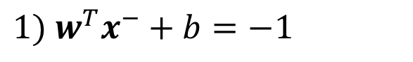
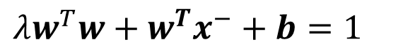
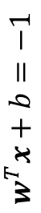
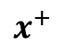
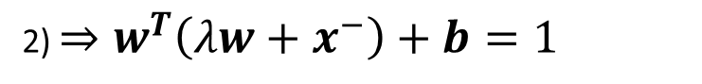
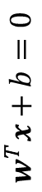









Step 2) Derive and Expression for the Margin (Back Again)
Things we assumed plus some geometry:
$${1) w}^{T}x^{−}+b=−1$$
$$3) x^{+}−x^{−}=λw$$
$$w^{T}x+b=1$$
$$w^{T}x+b=0$$
$$2) w^{T}x^{+}+b=1$$
$$w^{T}x+b=−1$$
Goal: Derive an expression for the margin $λ$
3) $⇒ x^{+}=λw+x^{−}$
$$w$$
$$x^{+}$$
$$x^{−}$$
2) $⇒w^{T}\left(λw+x^{−}\right)+b=1$
$$λw^{T}w+{w^{T}x}^{−}+b=1$$
Margin
$$λ$$
1) $⇒λw^{T}w−1=1$
$$⇒λ=\frac{2}{w^{T}w}=\frac{2}{{\left\|w\right\|}_{2}^{2}}$$

Slide 28


Step 3) Set Up A Constrained Optimization Problem (Again)
Maximize margin without making errors:
$$w^{T}x+b=1$$
$$w^{T}x+b=0$$
$$w^{T}x+b=−1$$
Maximize
margin
$$\max_{w,b}{\frac{2}{{\left\|w\right\|}_{2}^{2}}}$$
$$s.t. y_{i}\left(w^{T}x_{i}+b\right)≥1 ∀i$$
$$w$$
$$x^{+}$$
$$x^{−}$$
Such that no points are misclassified
Margin
$$λ=\frac{2}{{\left\|w\right\|}_{2}^{2}}$$

Slide 29



Recap Steps 1-3: We derived two objectives. How do they relate?
Version 1) Maximize minimum distance to boundary without making errors:
Version 2) Maximize margin width without making errors
$$\max_{w, b}\frac{1}{{\left\|w\right\|}_{2}}$$
$$s.t. y_{i}\left(w^{T}x_{i}+b\right)≥1 ∀i$$
$$\max_{w,b}{\frac{2}{{\left\|w\right\|}_{2}^{2}}}$$
$$s.t. y_{i}\left(w^{T}x_{i}+b\right)≥1 ∀i$$
These are proportional! Both are maximized by the same w*.
Could also write this problem as:
$$\min_{w,b}{ \frac{1}{2}w^{T}w}$$
$$s.t. y_{i}\left(w^{T}x_{i}+b\right)≥1 ∀i$$

Slide 30

Hard-Margin Support Vector Machine Objective
How do we actually solve this? And by “solve” I mean optimal find w and b
$$\min_{w,b}{ \frac{1}{2}w^{T}w}$$
$$s.t. y_{i}\left(w^{T}x_{i}+b\right)≥1 ∀i$$
This is a quadratic function with linear constraints. Many (non-trivial) algorithms to solve these sorts of things – called Quadratic Program Solvers (QP-Solvers).

Slide 31


Hard-Margin Support Vector Machine Objective
What is a Quadratic Program Solver? Given equations of the form:
Quadratic equation in matrix notation
$$\min_{z}{ \frac{1}{2}z^{T}Pz+q^{T}z}$$
$$s.t. Gz≤h \\ Az=b \\ b_{lower}≤z≤b_{upper}$$
Linear inequality constraints
Linear equality constraints
Limits on the values of x
Runs algorithms from optimization to provide the vector $z^{∗}$ that minimizes the function without violating the constraints. (Or returns infeasible if no such solution exits)
One example from Python (https://pypi.org/project/qpsolvers/)

Slide 32







Hard-Margin Support Vector Machine Objective
How can we put this into a quadratic form?
$$\min_{z}{ \frac{1}{2}z^{T}Pz+q^{T}z}$$
$$s.t. Gz≤h \\ Az=b \\ b_{lower}≤z≤b_{upper}$$
$$\min_{w,b}{ \frac{1}{2}w^{T}w}$$
$$s.t. y_{i}\left(w^{T}x_{i}+b\right)≥1 ∀i$$
$$q={\left[\begin{aligned}0 \\ ⋮ \\ 0\end{aligned}\right]}_{d+1}$$
$G={\left[\begin{aligned}y_{1}x_{1}^{T},y_{1} \\ y_{2}x_{2}^{T},y_{2} \\ y_{3}x_{3}^{T},y_{3} \\ ⋮ \\ y_{n}x_{n}^{T},y_{n}\end{aligned}\right]}_{n×d+1 }$
$$z={\left[\begin{aligned}w \\ b\end{aligned}\right]}_{d+1×1}$$
$$P={\left[\begin{aligned}I_{d} \\ 0\end{aligned}\begin{matrix}0 \\ 0\end{matrix}\right]}_{d+1×d+1}$$
$$h={\left[\begin{aligned}1 \\ ⋮ \\ 1\end{aligned}\right]}_{d+1}$$

Slide 33



Hard-Margin Support Vector Machine Objective
How can we put this into a quadratic form?
$\min_{w,b}{ \frac{1}{2}\left[w b\right]\left[\begin{aligned}I_{d} \\ 0\end{aligned}\begin{matrix}0 \\ 0\end{matrix}\right]\left[\begin{aligned}w \\ b\end{aligned}\right]}$ + ${\vec{0}}^{T}\left[\begin{aligned}w \\ b\end{aligned}\right]$
$$\min_{w,b}{ \frac{1}{2}w^{T}w}$$
$$s.t. y_{i}\left(w^{T}x_{i}+b\right)≥1 ∀i$$
$s.t. \left[\begin{aligned}y_{1}x_{1}^{T},y_{1} \\ y_{2}x_{2}^{T},y_{2} \\ y_{3}x_{3}^{T},y_{3} \\ ⋮ \\ y_{n}x_{n}^{T},y_{n}\end{aligned}\right]$ $\left[\begin{aligned}w \\ b\end{aligned}\right]≥\vec{1}$
Can pass this to a QP solver and let some optimization people deal with it.
For our purposes however, there is some deeper bit of understanding to be gained from pushing this further with another method – Lagrange multipliers.

Slide 34


Slide 35
Constrained Optimization with Lagrange Multipliers
To be very clear, the following is beyond the scope of this class and would be content in an optimization course. But we need the tool to move forward with our work here.
I’m going through this for completeness and to give you intuition for when I apply it later.
If you understand it, great. If not, don’t worry and focus on the outcome and conclusions.

Slide 36



Constrained Optimization with Lagrange Multipliers
Suppose we need to minimize some function given a set of constraints:
$$\min_{x}{f\left(x\right)}$$
$$s.t. g_{i}\left(x\right)≤0 for i=1,2,…m$$
For example, a quadratic function with one linear constraint:
$$\min_{x}{{ x}^{2}}$$
$$s.t. −10x+5≤0$$
In general, f and g_{i} can be arbitrary.

Slide 37

Constrained Optimization with Lagrange Multipliers
Write down an unconstrained function called the Lagrangian:
$$ℒ\left(x,α_{1},…,α_{m}\right)={f\left(x\right)+\sum_{i}^{m}{α_{i}g_{i}(x)}}$$
The original optimization problem is equivalent to solving the following:
Primal:
$$\min_{x}{\max_{α_{1},…, α_{m}}{ℒ\left(x,α_{1},…,α_{m}\right)} s.t. α_{i}≥0 ∀i}$$
By exchanging the order of min and max, we get the dual problem:
Dual:
$$\max_{α_{1},…, α_{m}}{\min_{x}{ℒ\left(x,α_{1},…,α_{m}\right)} s.t. α_{i}≥0 ∀i}$$

Slide 38






Constrained Optimization with Lagrange Multipliers
$$\min_{x}{{ x}^{2}}$$
$$s.t. −10x+5≤0$$
$$ℒ\left(x,α\right)={x^{2}+α\left(−10x+5\right)}$$
Dual:
$$\max_{α}{\min_{x}{ x^{2}+α(−10x+5)} s.t. α_{i}≥0 ∀i}$$
$$\frac{dℒ\left(x,α \right)}{dx}={2x−10α=0 ⇒ x=5α}$$
$$\frac{dℒ\left(x,α \right)}{dα}={−10x+5=0 }$$
$$⇒−50α+5=0$$
$$⇒α=\frac{1}{10}$$
$$⇒x=\frac{1}{2}$$

Slide 39


Constrained Optimization with Lagrange Multipliers
$$ℒ\left(x,α_{1},…,α_{m}\right)={f\left(x\right)+\sum_{i}^{m}{α_{i}g_{i}(x)}}$$
Think of these like a 2-player adversarial games with different turn order.
Primal:
$$\min_{x}{\max_{α_{1},…, α_{m}}{ℒ\left(x,α_{1},…,α_{m}\right)} s.t. α_{i}≥0 ∀i}$$
Dual:
$$\max_{α_{1},…, α_{m}}{\min_{x}{ℒ\left(x,α_{1},…,α_{m}\right)} s.t. α_{i}≥0 ∀i}$$
In the primal, the x-player goes first and tries to set whatever value of x minimizes things (ignoring constraints). Then the $α$-player goes and can set huge penalties anywhere a constraint is violated.
In the dual, the $α$-player goes first and tries to maximize things. Then the x-player goes and can try to minimize from there.

Slide 40

Constrained Optimization with Lagrange Multipliers
$$ℒ\left(x,α_{1},…,α_{m}\right)={f\left(x\right)+\sum_{i}^{m}{α_{i}g_{i}(x)}}$$
Duality Gap: max of min is often lower than min of max.
Primal:
$$\min_{x}{\max_{α_{1},…, α_{m}}{ℒ\left(x,α_{1},…,α_{m}\right)} s.t. α_{i}≥0 ∀i}$$
Dual:
$$\max_{α_{1},…, α_{m}}{\min_{x}{ℒ\left(x,α_{1},…,α_{m}\right)} s.t. α_{i}≥0 ∀i}$$
Karush-Kuhn-Tucker (KKT) Conditions tell us when the dual and primal have the same optimal solutions $x^{∗}, α_{1}^{∗}, …, α_{m}^{∗}$ for convex $f\left(x\right):$
$∇ℒ\left(x^{∗}, α_{1}^{∗}, …, α_{m}^{∗}\right)=0$ At a critical point of the Lagrangian
$g\left(x^{∗}\right)≤0$ The solution satisfies the primal constraints
$α_{i}^{∗}≥0$ The solution satisfies the dual constraints
$α^{∗}g\left(x^{∗}\right)=0$ Complementary slackness.

Slide 41



Constrained Optimization with Lagrange Multipliers
$$\min_{x}{{ x}^{2}}$$
$$s.t. −10x+5≤0$$
$$ℒ\left(x,α\right)={x^{2}+α\left(−10x+5\right)}$$
$$x^{∗}=\frac{1}{2}$$
$$α^{∗}=\frac{1}{5}$$
Karush-Kuhn-Tucker (KKT) Conditions tell us when the dual and primal have the same optimal solutions $x^{∗}, α_{1}^{∗}, …, α_{m}^{∗}$ for convex $f\left(x\right):$
$\frac{δℒ(x^{∗}, α^{∗})}{dx}=0,\frac{δℒ(x^{∗}, α^{∗})}{dα}=0$ At a critical point of the Lagrangian
$−10x^{∗}+5≤0$ The solution satisfies the primal constraints
$α^{∗}≥0$ The solution satisfies the dual constraints
$α^{∗}(−10x^{∗}+5)=0$ Complementary slackness.

Slide 42
Constrained Optimization with Lagrange Multipliers

Slide 43

Hard-Margin Support Vector Machine Objective
Where were we? We wanted to solve the constrained optimization problem below because it maximizes the margin while having no errors.
$$\min_{w,b}{ \frac{1}{2}w^{T}w}$$
$$s.t. y_{i}\left(w^{T}x_{i}+b\right)≥1 ∀i$$
Let’s start getting this into shape to apply the Langrange multipliers bit.

Slide 44


Hard-Margin Support Vector Machine Objective
Need to get our inequality facing the right way. Multiply by -1 and move the right side over:
$$\min_{w,b}{ \frac{1}{2}w^{T}w}$$
$$s.t. y_{i}\left(w^{T}x_{i}+b\right)≥1 ∀i$$
$$\min_{w,b}{ \frac{1}{2}w^{T}w}$$
$$s.t. {1−y}_{i}\left(w^{T}x_{i}+b\right)≤0 ∀i$$

Slide 45




Hard-Margin Support Vector Machine Objective
$$\min_{w,b}{ {\frac{1}{2}w}^{T}w}$$
$$s.t. {1−y}_{i}\left(w^{T}x_{i}+b\right)≤0 ∀i$$
Let’s write out the Lagrangian:
$$ℒ\left(w, b,α_{i}, …, α_{n}\right)= {\frac{1}{2}w}^{T}w+\sum_{i=1}^{n}{α_{i}}\left({1−y}_{i}\left(w^{T}x_{i}+b\right)\right)$$
$$= {\frac{1}{2}w}^{T}w+\sum_{i=1}^{n}{α_{i}}{−\sum_{i=1}^{n}{α_{i}}y}_{i}w^{T}x_{i}{−\sum_{i=1}^{n}{α_{i}}y}_{i}b$$
Want to solve the dual problem:
$$\max_{α_{i}≥0}{\min_{w,b}{{\frac{1}{2}w}^{T}w+\sum_{i=1}^{n}{α_{i}}{−\sum_{i=1}^{n}{α_{i}}y}_{i}w^{T}x_{i}{−\sum_{i=1}^{n}{α_{i}}y}_{i}b}}$$

Slide 46



Hard-Margin Support Vector Machine Objective
$$\max_{α_{i}≥0}{\min_{w}{{\frac{1}{2}w}^{T}w+\sum_{i=1}^{n}{α_{i}}{−\sum_{i=1}^{n}{α_{i}}y}_{i}w^{T}x_{i}{−\sum_{i=1}^{n}{α_{i}}y}_{i}b}}$$
Take derivatives and set equal to zero:
$$\frac{δℒ}{δw}=w{−\sum_{i=1}^{n}{α_{i}}y}_{i}x_{i}=0 ⇒ w={\sum_{i=1}^{n}{α_{i}}y}_{i}x_{i}$$
$$\frac{δℒ}{δb}={−\sum_{i=1}^{n}{α_{i}}y}_{i}=0$$

Slide 47




Hard-Margin Support Vector Machine Objective
$$\max_{α_{i}≥0}{\min_{w}{{\frac{1}{2}w}^{T}w+\sum_{i=1}^{n}{α_{i}}{−\sum_{i=1}^{n}{α_{i}}y}_{i}w^{T}x_{i}{−\sum_{i=1}^{n}{α_{i}}y}_{i}b}}$$
$$w={\sum_{i=1}^{n}{α_{i}}y}_{i}x_{i}$$
$${\sum_{i=1}^{n}{α_{i}}y}_{i}=0$$
Apply what we learned from the derivatives:
$$\max_{α_{i}≥0}{{\frac{1}{2}\left({\sum_{i=1}^{n}{α_{i}}y}_{i}x_{i}\right)}^{T}\left({\sum_{j=1}^{n}{α_{j}}y}_{j}x_{j}\right)+\sum_{i=1}^{n}{α_{i}}{−\sum_{i=1}^{n}{α_{i}}y}_{i}{\left({\sum_{j=1}^{n}{α_{j}}y}_{j}x_{j}\right)}^{T}x_{i}{−b\sum_{i=1}^{n}{α_{i}}y}_{i}}$$
$$\max_{α_{i}≥0}{\sum_{i=1}^{n}{α_{i}}−\frac{1}{2}\sum_{i}^{n}{\sum_{j}^{n}{α_{i}α_{j}y_{i}y_{j}x_{i}^{T}x_{j}}}} s.t. {\sum_{i=1}^{n}{α_{i}}y}_{i}=0$$

Slide 48


Hard-Margin Support Vector Machine Objective
$$\max_{α_{i}≥0}{\sum_{i=1}^{n}{α_{i}}−\frac{1}{2}\sum_{i}^{n}{\sum_{j}^{n}{α_{i}α_{j}y_{i}y_{j}x_{i}^{T}x_{j}}}} s.t. {\sum_{i=1}^{n}{α_{i}}y}_{i}=0$$
This is a quadratic function with linear constraints. Many (non-trivial) algorithms to solve these sorts of things – called Quadratic Program Solvers (QP-Solvers). I can put this into a QP solver and get back out optimal $α_{i}^{∗}$.
Further, the KKT conditions hold (not shown here) such that solving this yields the exact same optimal solution as the original formalization!

Slide 49


Slide 50


Please accept this majestic photo of my friend’s cat Simba for sticking with me

Slide 51


Recap of what we’ve been doing so far
Motivation: We wanted to find a classifier that maximizes the margin between classes.
Derivation: We derived the following constrained optimization problem that does that:
Hard-Margin SVM Primal:
$$\min_{w,b}{ \frac{1}{2}w^{T}w} s.t. y_{i}\left(w^{T}x_{i}+b\right)≥1 ∀i$$
We said that is a Quadratic Programming problem and totally solvable. Then I ran us through a lot of math to arrive at the dual formalization below which solves the same problem (KKT’s hold).
Hard-Margin SVM Dual:
$$\max_{α_{i}≥0}{\sum_{i=1}^{n}{α_{i}}−\frac{1}{2}\sum_{i}^{n}{\sum_{j}^{n}{α_{i}α_{j}y_{i}y_{j}x_{i}^{T}x_{j}}}} s.t. {\sum_{i=1}^{n}{α_{i}}y}_{i}=0$$
Which is also a Quadratic Programming problem (in $α$’s this time rather than w) and is totally solvable to global optimality….. …. so why did I do this to us all?

Slide 52
Why have we done all this?
Hard math builds character.

Slide 53


Examining the Dual Solution
Real Reason: We can examine this dual formalization to observe some very, very interesting things that are not at all apparent in the primal formalization!
Observation 1: For optimal $α_{i}^{∗}$ found by maximizing the dual problem, the optimal weight vector turns out to be a weighted sum of input vectors times their labels:
We found this back when we took derivatives.
$$w^{∗}={\sum_{i=1}^{n}{α_{i}^{∗}}y}_{i}x_{i}$$
Arises from KKT conditions, next slide.
$$b^{∗}=\frac{1}{\sum_{i=1}^{n}{α_{i}^{∗}}}\sum_{i=1}^{n}{α_{i}^{∗}(y_{i}−w^{∗^{T}}x_{i})}$$

Slide 54


Examining the Dual Solution
Observation 2: Only certain training examples influence the result. Many of the $α_{i}$’s are zero.
At optimality, the KKT conditions require that:
$$α_{i}≥0 ∀i$$
← Satisfies dual constraints
$$y_{i}\left({w^{∗}}^{T}x_{i}+b\right)≥1, ∀i$$
← Satisfies primal constraints
$$α_{i}^{∗}\left(y_{i}\left({w^{∗}}^{T}x_{i}+b\right)−1\right)=0, ∀i$$
← Complementary slackness

Slide 55

What does the complementary slackness condition $α_{i}^{∗}\left(y_{i}\left({w^{∗}}^{T}x_{i}+b\right)−1\right)=0, ∀i$ imply about the values of the alpha variables?
(Think about when this equation is true for a single training point i)

Slide 56
Examining the Dual Solution
Observation 2: Only certain training examples influence the result. Many of the $α_{i}$’s are zero.
At optimality, the KKT conditions require that:
$$α_{i}≥0 ∀i$$
← Satisfies dual constraints
$$y_{i}\left({w^{∗}}^{T}x_{i}+b\right)≥1, ∀i$$
← Satisfies primal constraints
$$α_{i}^{∗}\left(y_{i}\left({w^{∗}}^{T}x_{i}+b\right)−1\right)=0, ∀i$$
← Complementary slackness
$α_{i}^{∗}$ is only non-zero if $y_{i}\left(w^{T}x_{i}+b\right)=1$!

Slide 57







Examining the Dual Solution
$α_{i}^{∗}$ is only non-zero if $y_{i}\left(w^{T}x_{i}+b\right)=1$!
$$w^{T}x+b=1$$
$$w^{T}x+b=0$$
$$w^{T}x+b=−1$$
$α_{i}^{∗}$ is only non-zero if $x_{i}$ is on the margin edges (green or red line)
$$w$$
$$w^{∗}={\sum_{i=1}^{n}{α_{i}^{∗}}y}_{i}x_{i}$$
Only the points on the margin matter to the classifier weights.

Slide 58
Examining the Dual Solution
Call these points with non-zero alpha support vectors.
$$w^{T}x+b=1$$
$$w^{T}x+b=0$$
$$w^{T}x+b=−1$$
$$w$$

Slide 59


Examining the Dual Solution
How is a new point classified?
Our decision rule is:
$$w^{T}x+b>0 ⇒ predict 1$$
$$w^{T}x+b<0 ⇒ predict −1$$
$$w^{T}x+b=1$$
$$w^{T}x+b=0$$
$$w^{T}x+b=−1$$
$$w$$
?
Plugging in our optimal weight:
$$w^{∗}={\sum_{i=1}^{n}{α_{i}^{∗}}y}_{i}x_{i} ⇒ w^{T}x+b=b+ {\sum_{i=1}^{n}{α_{i}^{∗}}y}_{i}x_{i}^{T}x$$
The prediction is based on dot product with a sparse set of training examples.

Slide 60
Web Demo
https://jgreitemann.github.io/svm-demo

Slide 61
What you need to know from today’s lecture:
Support Vector Machines (SVMs) find the decision boundary that maximizes the margin between the positive and negative points.
The weight vector corresponding to this max-margin classifier can be found by solving a constrained optimization problem with a QP solver.
By going through the effort of examining the Lagrangian dual of the SVM objective, we found that the decision boundary is a function of a small, sparse set of examples that lie on the classifier’s margin.
What we derived today is referred to as a hard-margin SVM because it does not tolerate any errors. If we give it a non-linearly separable dataset, the QP solver will report no feasible solution.

Slide 62

Teaser for Next Time: What about the non-linearly separable case?
Teaser 1: We can modify our objective function to try to maximize margin while making as few mistakes as possible. Will need to introduce some notion of the tradeoff between the two.
Maximize margin
Minimize violations of the margin
$$\min_{w,b}{ \frac{1}{2}w^{T}w}+C\sum_{i}{ε_{i}}$$
$$s.t. y_{i}\left(w^{T}x_{i}+b\right)≥1−ε_{i} ∀i \\ ε_{i}≥0$$
Allow some violations
We’ll talk about how this works out next time.

Slide 63




Teaser for Next Time: What about the non-linearly separable case?
Teaser 2: Apply the non-linear basis function idea again and just replace each point with some $Φ\left(x\right)$ that is non-linear. Then fit a linear classifier in that higher-dimensional space.
Train and find $w^{∗}={\sum_{i=1}^{n}{α_{i}^{∗}}y}_{i}Φ{(x}_{i})$
$$b+ {\sum_{i=1}^{n}{α_{i}^{∗}}y}_{i}Φ{\left(x_{i}\right)}^{T}Φ(x)$$
Predict based on $w^{T}Φ(x)+b$
This is expensive and we have to deal with those higher dimensions. What if we just defined a kernel that compute non-linear similarity without actually representing these high dimensional vectors.
SVMs operate on dot products between examples. Can “pretend” we are in a higher dimension – call this the kernel trick. More next time.
$$b+ {\sum_{i=1}^{n}{α_{i}^{∗}}y}_{i}𝓚(x_{i},x)$$
$$\max_{α_{i}≥0}{\sum_{i=1}^{n}{α_{i}}−\frac{1}{2}\sum_{i}^{n}{\sum_{j}^{n}{α_{i}α_{j}y_{i}y_{j}𝓚(x_{i},x_{j})}}}$$

Slide 64
Next time
Next Time: How do we deal with non-linearly separable data? Kernels + Soft-Margin SVM.

